Slide 2
Core is the new Black Modern Framework for Modern Apps
Giancarlo Lelli
Avanade Italy / @itsonlyGianca / gcarlo.lelli@live.com

Slide 3



Grazie ai nostri sponsor

Slide 4










Your platform for building anything
DESKTOP
WEB
CLOUD
MOBILE
GAMING
IoT
AI
.NET
Notes:
You can build anything with .NET. We’ve made significant investments in .NET over the years as well as unifying the ecosystem to support building literally anything.

Slide 5
.NET Growth Continues
Visual Studio
+1 million new monthly active .NET developers in last year
.NET Core
Over half a million .NET Core 2.0 developers

Slide 6
Now Available .NET Core 2.1!
www.dot.net

Slide 7
.NET Core 2.1 on TechEmpower
REQUESTS / SECOND
+15%
+18%
+147%
Data sourced from tests on TechEmpower round 16
Notes:
Call out the incredible performance increase in the REAL WORLD data access scenario.

Slide 8
.NET Core 2.1 Major Features
.NET Core
Lazy Loading
Value conversions
Query types
Data seeding
ASP.NET Core
Global Tools
Span<T>
Sockets
HttpClient Performance
Windows Compatibility Pack
EF Core
HTTPS
Razor UI as a library
HttpClientFactory
ASP.NET Core SignalR

Slide 9
Announcing .NET Core 2.2 Preview 2
https://aka.ms/DotNetCore22

Slide 10
.NET Core 2.2 Themes
Improved Web API Development
Microservices and Azure
Continued Performance Improvements

Slide 11
.NET Core 2.2 Major Features
.NET Core
Cosmos DB provider
Spatial extensions for SQL Server and SQLite providers
Reverse engineering of database views
Collections of owned entities
Query tagging
ASP.NET Core
Multi-tier JIT compilation
SQL Connection token auth
EF Core
Template updates: Bootstrap 4, Angular 6
Web API improvements, including API security
HTTP/2
IIS in-process hosting
Health checks
Endpoint routing
SignalR Java client

Slide 12
.NET Core
3
2
.NET Core 3 expands supported workloads to include Windows Desktop, IoT & AI
.NET Core is perfectly suited for the requirements of cloud-native, cross-platform workloads
WEB
CLOUD
DESKTOP
IoT
AI
.NET CORE
.NET CORE 3
LIBRARIES
INFRASTRUCTURE
RUNTIME COMPONENTS
COMPILERS
LANGUAGES
Notes:
ANIMATED SLIDE – shows progression of entire .NET platform into .NET Core specific workloads.
.NET Core is our cross-platform, open source implementation of .NET and is perfectly suited for requirements of cloud-native, cross-platform services. We’ve made significant investments in the core performance as well as the web stack so that you can easily take advantage of cloud patterns and scale.
.NET Core 3 will expand on the supported workloads to include IoT, AI and Windows Desktop.

Slide 13
.NET Core 3 Desktop Improvements
.NET Core 3 supports WinForms and WPF frameworks
XAML Islands - WinForms & WPF can host UWP
XAML Controls – WinForms & WPF browser and media UWP controls
High DPI fixes for WinForms
Access to all the Windows 10 API’s
NET Core App Bundler
Precompiled, fast startup
Small apps by removing unused dependencies, link away unused IL
Single self-contained .exe

Slide 14
Why Windows Desktop on .NET Core?
Side by side
Machine global or app local framework
Core runtime and API improvements
SDK based .csproj project system

Slide 15
Update on .NET Core 3 since Build 2018
WinForms support available in nightly builds
https://github.com/dotnet/core-sdk
dotnet new winforms
Visual Studio supports building and debugging
Designers not available yet
Publish Preview later this year

Slide 16
ASP.NET Core 2.2 Preview 2

Slide 17
Get started with ASP.NET Core 2.2 Preview 2
Install the .NET Core 2.2 Preview 2 SDK
https://www.microsoft.com/net/download/dotnet-core/2.2
Install Visual Studio 2017 15.9 Preview 2
https://visualstudio.com/preview/

Slide 18
ASP.NET Core 2.2 features
Template updates: Bootstrap 4, Angular 6
Web API improvements
HTTP/2
IIS in-process hosting
Health checks
Endpoint routing
SignalR Java client

Slide 19




APIs are everywhere!
APIs
APIs
APIs
APIs

Slide 20
Web API improvements in ASP.NET Core 2.2
Easier to create
Easier to test & debug
Easier to document
Easier to consume
Easier to secure
Easier to monitor
Improved performance
→ API Scaffolding
→ HTTP REPL, Problem Details
→ API conventions & analyzer
→ Code generation (Preview 3)
→ Web API security (Preview 3)
→ Health checks integration
→ HTTP/2, endpoint routing, IIS in-proc hosting

Slide 21
HTTP/2
Now available cross-platform in Kestrel
Application-Layer Protocol Negotiation (ALPN)
Header compression
Multiplexed streams over same connection
Some limitations
Server push, stream prioritization not currently supported
Not supported for edge use at this time

Slide 22
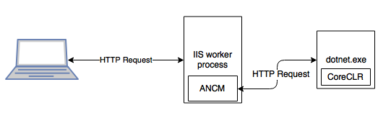
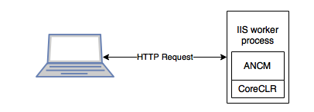
IIS in-process hosting
Out of process (current)
In process (NEW!)

Slide 23
IIS in-process hosting
Improved performance, reliability, and diagnostics

Slide 24
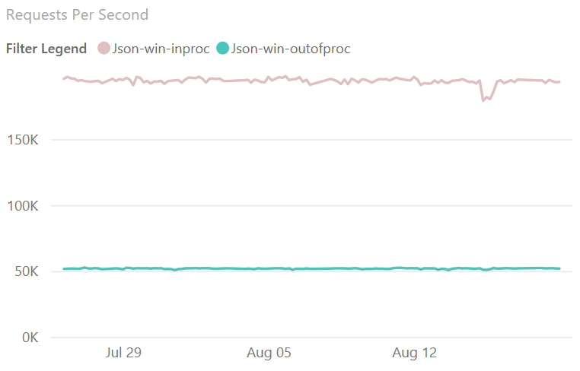
IIS in-process hosting – Performance!
4x
faster!

Slide 25
Health checks
Add dedicated health endpoints to your application
Integrate with container orchestrators and load balancers
Support liveness and readiness probes

Slide 26
Endpoint routing
New routing implementation
On by default for 2.2 with compatibility switches
Better throughput (~10%) and scalability
Link to endpoints from outside of MVC
Various minor improvements
Parameter transformers, new catch all syntax {**path}

Slide 27
ASP.NET Core 2.2 features
Template updates: Bootstrap 4, Angular 6
Web API improvements
HTTP/2
IIS in-process hosting
Health checks
Endpoint routing
SignalR Java client

Slide 28
ASP.NET Core 2.2 schedule
Preview 2 - Sept
Preview 3 – Oct
RTW – Year-end 2018

Slide 29
SignalR Java client
Connect to ASP.NET Core SignalR hubs in Java
Available via Gradle and Maven
Now supports Azure SignalR Service
Complete Android sample
https://github.com/aspnet/SignalR-samples/tree/master/AndroidJavaClient

Slide 30
What is .NET Standard?

Slide 31
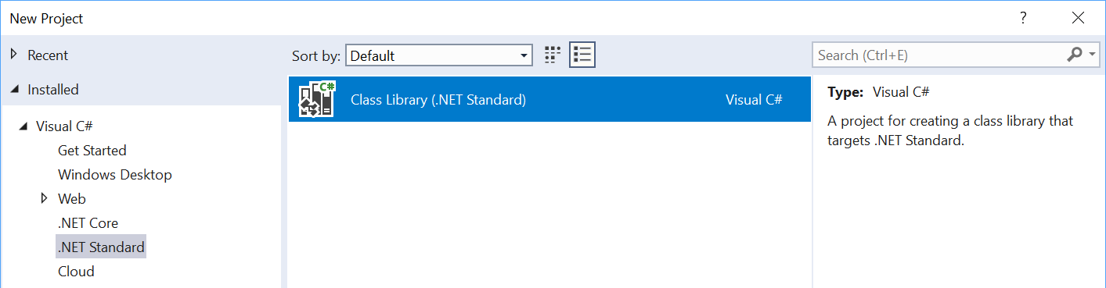
What is .NET Standard?
.NET Standard is a specification
A set of APIs all .NET platforms have to implement
.NET Standard
.NET Core
.NET Framework
Xamarin
~
~
HTML specification
Browsers
$ dotnet new classlib -o My.Class.Library

Slide 32
.NET Standard in context
.NET FRAMEWORK
.NET CORE
XAMARIN
.NET Standard

Slide 33
What’s in .NET Standard?
Microsoft.Win32.SafeHandles
System
System.CodeDom.Compiler
System.Collections
System.Collections.Concurrent
System.Collections.Generic
System.Collections.ObjectModel
System.Collections.Specialized
System.ComponentModel
System.ComponentModel.Design
System.ComponentModel.Design.Serialization
System.Configuration.Assemblies
System.Data
System.Data.Common
System.Data.SqlTypes
System.Diagnostics
System.Diagnostics.CodeAnalysis
System.Diagnostics.Contracts
System.Diagnostics.SymbolStore
System.Diagnostics.Tracing
System.Drawing
System.Dynamic
System.Globalization
System.IO
System.IO.Compression
System.IO.IsolatedStorage
System.IO.MemoryMappedFiles
System.IO.Pipes
System.Linq
System.Linq.Expressions
System.Net
System.Net.Cache
System.Net.Http
System.Net.Http.Headers
System.Net.Mail
System.Net.Mime
System.Net.NetworkInformation
System.Net.Security
System.Net.Sockets
System.Net.WebSockets
System.Numerics
System.Reflection
System.Reflection.Emit
System.Resources
System.Runtime
System.Runtime.CompilerServices
System.Runtime.ConstrainedExecution
System.Runtime.ExceptionServices
System.Runtime.InteropServices
System.Runtime.InteropServices.ComTypes
System.Runtime.Serialization
System.Runtime.Serialization.Formatters
System.Runtime.Serialization.Formatters.Binary
System.Runtime.Serialization.Json
System.Runtime.Versioning
System.Security
System.Security.Authentication
System.Security.Authentication.ExtendedProtection
System.Security.Claims
System.Security.Cryptography
System.Security.Cryptography.X509Certificates
System.Security.Permissions
System.Security.Principal
System.Text
System.Text.RegularExpressions
System.Threading
System.Threading.Tasks
System.Timers
System.Transactions
System.Windows.Input
System.Xml
System.Xml.Linq
System.Xml.Resolvers
System.Xml.Schema
System.Xml.Serialization
System.Xml.XPath
System.Xml.Xsl
All the foundational APIs
~37k APIs in .NET Standard 2.0

Slide 34
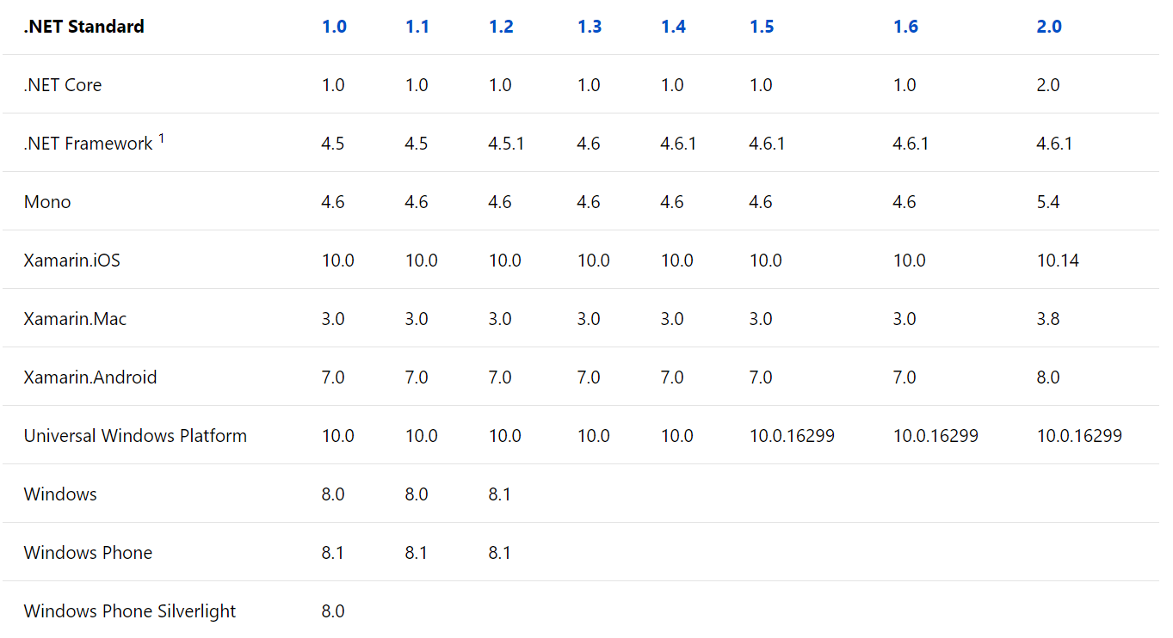
Versions of .NET Standard
Don’t worry about it.
Start with .NET Standard 2.0.

Slide 35
.NET Standard is also Open Source!
Anybody can propose API additions
The review board approves the API
Has representatives from the .NET Foundation, Microsoft, Xamarin/Mono, & Unity
Acceptance requires
A stable implementation that is shipped in at least one .NET implementation
Sponsorship from a board member
Next version is planned here:
https://github.com/dotnet/standard/tree/master/docs/planning/netstandard-2.1

Slide 36
Using platform-specific APIs from .NET Standard

Slide 37
Windows Compatibility Pack
Microsoft.Windows.Compatibility (NuGet package)
Can be referenced from .NET Core as well as from .NET Standard
Has ~21k APIs (Windows-only as well as cross-platform)
Contents
ACLs
Code Pages
CodeDom
Configuration
Crypto
DirectoryServices
Drawing
EventLog
MEF v1
Odbc
Perf Counters
Permissions
Ports
Registry
Runtime Caching
WCF
Windows Services
…

Slide 38
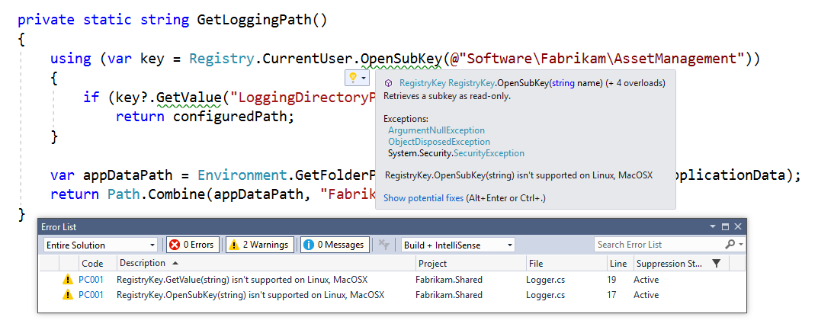
Detecting usage of unsupported APIs
Use API Analyzer!
https://aka.ms/apianalyzer
Roslyn analyzer that flags usages of APIs that don’t work across all platforms

Slide 39
Multi-Targeting Best Practices
DO start with .NET Standard 2.0
Most general purpose libraries will not need APIs outside this set.
CONSIDER targeting multiple frameworks
If you need to call platform-specific APIs outside of .NET Standard
DO NOT drop support for .NET Standard
Instead, throw from the implementation and offer capability APIs. This way, your library can used anywhere and supports runtime light-up.
DO share your component using a NuGet package
It shields consumers from having to pick the appropriate implementation.
CONSIDER using MSBuild.Sdk.Extras
Thanks Oren! ☺

Slide 40
.NET Standard & .NET Framework

Slide 41
Sorry.
We retroactively made .NET Framework 4.6.1 support .NET Standard 2.0
Turns out this was a mistake as it has a tail of issues.
Lesson learned for us: after a .NET platform has shipped, the version of .NET Standard it supports should be considered immutable.
.NET Framework 4.7.2 is the recommended version to consume .NET Standard 1.5+
Application authors: consider upgrading
Library authors: consider multi-targeting for .NET Framework 4.6.1

Slide 42
Strong naming
Key signing to give assemblies an additional piece for the name
MyLibrary, Version=1.0.0.0, Culture=neutral, PublicKeyToken=70d3c3735d2363d4
Don’t confuse strong names with Authenticode signing, the industry standard based on certificates for indicating who authored a specific binary
Disambiguates assemblies with the same simple name (such as “Calculator”)
Required for GAC or for loading assemblies side-by-side

Slide 43
Strong naming
Strong naming is generally viral
Strong named assemblies can only reference strong named assemblies
Adding or removing a strong name is a binary breaking change
We recommend that you:
Strong name your libraries from the get-go
Check in the public and private key into your OSS repos
Do not make security decisions based on the strong name

Slide 44
Binding redirects
A .NET Framework-only concept
Only loads assemblies where the referenced version matches the version on disk
Problematic when someone references an older version while your app deploys a higher version
To accept a higher version, your app.config needs to explicitly allow for that by adding a redirect:
<assemblyBinding xmlns="urn:schemas-microsoft-com:asm.v1" appliesTo="v1.0.3705">
<dependentAssembly>
<assemblyIdentity name="System.Collections.Immutable"
publicKeyToken="b03f5f7f11d50a3a“
culture="neutral"/>
<bindingRedirect oldVersion="0.0.0.0-1.2.2.0" newVersion="1.2.2.0"/>
</dependentAssembly>
</assemblyBinding>

Slide 45
Tips

Slide 46
Versioning
You need to know about four version numbers:
Kind | When to increment | Comment
Package Version | Every change | The ID of the NuGet package.
Assembly Version | As you see fit | The version number of the assembly. Used by the loader to resolve assemblies.
File Version | Every change | Generic concept, used by installers to determine which file is newer.
Informational Version | As you see fit | Display string, doesn’t need to be a version.

Slide 47
Best Practices
DO follow the API Design Guidelines
DO target .NET Standard 2.0
CONSIDER using multi-targeting to allow for platform-specific code
CONSIDER dual-targeting for .NET Framework 4.6.1
DO use NuGet for packaging multi-targeted libraries
DO throw PlatformNotSupportedException for unsupported APIs
CONSIDER offering capability APIs so that consumers can check upfront
DO strong name your libraries
AVOID if your library can’t be used on .NET Framework
DO check in the public & private key

Slide 48
Under the hood

Slide 49
What can you reference from .NET Standard?
.NET FRAMEWORK
.NET CORE
XAMARIN
Legend
My Standard Library 2.x
Is able to reference
Application Type
Via Portability
.NET Standard Library
Portable Class Library
.NET Framework Library
Via Compatibility Shim

Slide 50
.NET Standard under the hood
YOUR .NET STANDARD-BASED CLASS LIBRARY
NETSTANDARD.DLL
TYPE
FORWARDING
.NET FRAMEWORK OR PORTABLE CLASS LIBRARY
EXISTING .NET FRAMEWORK CLASS LIBRARY
MSCORLIB.DLL
MSCORLIB.DLL
MSCORLIB.DLL
FRAMEWORK ASSEMBLIES
This happens when you build a .NET Standard-based Library

Slide 51
.NET Standard under the hood
YOUR .NET APPLICATION
FRAMEWORK ASSEMBLIES
TYPE
FORWARDING
YOUR .NET STANDARD-BASED CLASS LIBRARY
NETSTANDARD.DLL
This happens when you load .NET Standard-based library

Slide 52
Platform specific APIs & .NET Standard
YOUR .NET STANDARD-BASED CLASS LIBRARY
NETSTANDARD.DLL
TYPE
FORWARDING
TYPE
FORWARDING
PLATFORM-SPECIFIC EXTENSION
REGISTRY.DLL
MSCORLIB.DLL
MSCORLIB.DLL
MSCORLIB.DLL
FRAMEWORK ASSEMBLIES
This happens when you build a .NET Standard-based library with platform-specific extensions

Slide 53
Platform specific APIs & .NET Standard
YOUR .NET APPLICATION
FRAMEWORK ASSEMBLIES
YOUR .NET STANDARD-BASED CLASS LIBRARY
SUPPORTED EXTENSION
TYPE
FORWARDING
EXCEPTION
UNSUPPORTED EXTENSION
This happens when you load .NET Standard-based library with platform-specific extensions

